Slide 1

UNIT -3
DISASTERS
Manjunathgouda M Patil, Asst.Prof. GIT Belgaum

Slide 2
OUTLINES
What do you mean by a disaster?
Disaster Characteristics
Classification of Disasters
Natural Disaster
  Characteristics of Natural Disasters
  Impact of Natural Disasters
  Trends of World Natural Disasters 1984-2013
  Impacts of World Natural Disasters by region, 1984-2013
Manjunathgouda M Patil, Asst.Prof. GIT Belgaum

Slide 3

WHAT DO YOU MEAN BY A DISASTER?
Disaster is the occurrence of a sudden or major misfortune, which disrupts the basic fabric, and normal functioning of a society.
The High Powered Committee of the Government of India, in its October 2001 Report defines Disaster as “an occurrence of a severity and magnitude that normally results in deaths, injuries and property damage and that cannot be managed through the routine procedures and resources of government. It usually develops suddenly and unexpectedly and requires immediate, coordinated and effective response by multiple government and private sector organizations to meet human needs and speedy recovery”.
Manjunathgouda M Patil, Asst.Prof. GIT Belgaum

Slide 4
WHAT DO YOU MEAN BY A DISASTER?
The Disaster Management Act 2005 defines disaster as “a catastrophe, mishap, calamity or grave occurrence affecting any area, arising from natural of manmade causes, or by accident or negligence which results in substantial loss of life or human suffering or damage to, and destruction of, property, or damage to, or degradation of, environment, and is of such a nature magnitude as beyond the coping capacity of the community of the affected area”.
WHO defines disaster as ‘any occurrence that causes damage, economic destruction, loss of human life and deterioration in health and health services on a scale sufficient to warrant an extraordinary response from outside the affected community or area.’
Manjunathgouda M Patil, Asst.Prof. GIT Belgaum

Slide 5

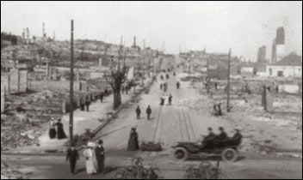
Disaster Characteristics
Increased death, injury, illness that can’t be managed
Coordination public, government, and private organizations
Equal triage distribution
Notification of family
Evacuation/Sheltering of evacuees
Manjunathgouda M Patil, Asst.Prof. GIT Belgaum
Notes:
Every disaster man-made or natural has similar characteristics.
Photo of San Francisco post 1905 Earthquake that leveled and burned down the city.
Coordination is between the state and federal stakeholders
Equal triage means spreading victims around health care system and community – do not overwhelm the system

Slide 6

Disaster Characteristics
Disaster Characteristics
Media attention
Heightened security; crime scene
Immediate and long term emotional support
Significant property damage
Manjunathgouda M Patil, Asst.Prof. GIT Belgaum
Notes:
Media is relied on as part of public information; they are often on the scene before fist responders

Slide 7
Classification of Disasters
Disasters identified by the High Powered Committee in 2001
I. Water and Climate related disaster
  1. Floods and Drainage Management 2. Cyclones
  3. Tornadoes and Hurricanes 4. Hailstorm
  5. Cloud Burst 6. Heat Wave and Cold Wave
  7. Snow Avalanches 8. Droughts
  9. Sea Erosion 10. Thunder and Lighting
II. Geologically related disasters
1. Landslides and Mudflows
2. Earthquakes
3. Dam Failures/Dam Bursts
4. Mine Fires
Manjunathgouda M Patil, Asst.Prof. GIT Belgaum

Slide 8
Classification of Disasters
III. Chemical, Industrial and Nuclear related disasters
  1. Chemical and Industrial Disasters
  2. Nuclear Chemicals
IV. Accident related disasters
  1. Forest Fires 2. Urban Fires
  3. Mine Flooding 4. Oil Spill
  5. Major Building Collapse 6. Serial Bomb Blast
  7. Festival Disasters and Fires 8. Electrical Disasters and Fires
  9. Air, Road and Rail Accidents 10. Boat Capsizing
  11. Village Fire
V. Biologically related disasters
  1. Biological Disaster and Epidemics
  2. Pest Attacks
  3. Cattle Epidemics
  4. Food Poisoning
Manjunathgouda M Patil, Asst.Prof. GIT Belgaum

Slide 9
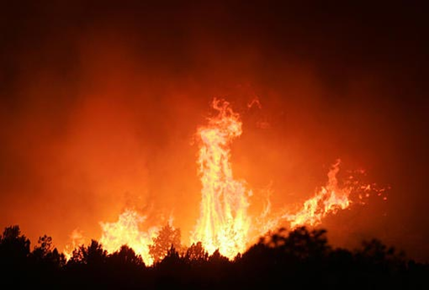
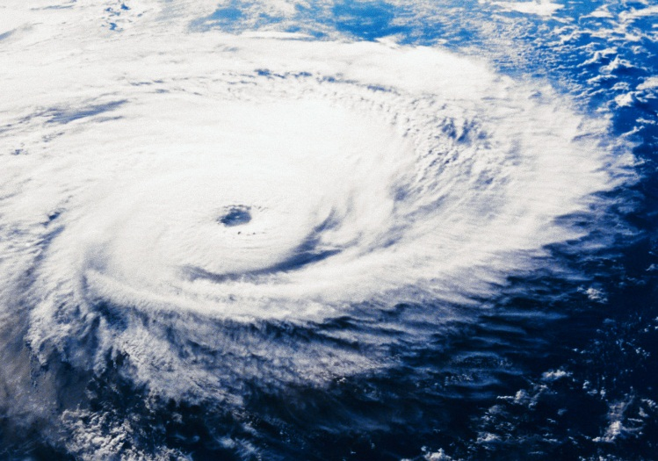
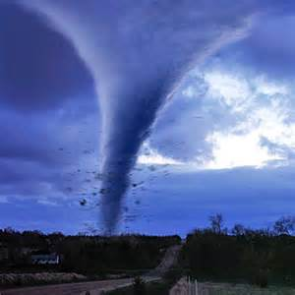
NATURAL DISASTERS
These types of disaster naturally occur in proximity to, and pose a threat to, people, structures or economic assets. They are caused by biological, geological, seismic, hydrologic, or meteorological conditions or processes in the natural environment (e.g., cyclones, earthquakes, tsunami, floods, landslides, and volcanic eruptions).
Manjunathgouda M Patil, Asst.Prof. GIT Belgaum

Slide 10
NATURAL DISASTERS
Tornadoes
Forest Fires
Floods
Blizzards
Cyclones/Typhoon
Hurricanes
Heatwave
Tsunami
Volcanic Eruption
Earthquakes
Mudslides
Limbic Eruption
Draught/Famine
Hail
Manjunathgouda M Patil, Asst.Prof. GIT Belgaum

Slide 11
CHARACTERISTICS OF NATURAL DISASTERS
Regional Characteristics of Natural Disasters
Disaster Characteristics in Asia:
  Asia has been suffering from about 38 % of the major natural disasters of the world.
  Meanwhile, Asian region accounts for 57 % of killed people by natural disasters and 88 % of the affected people.
  The number of people killed and affected, and the amount of damage tend to be higher compared to the number of disasters.
  Therefore Asian region cannot be neglected as one of vulnerable areas to natural disasters.
Manjunathgouda M Patil, Asst.Prof. GIT Belgaum

Slide 12
CHARACTERISTICS OF NATURAL DISASTERS
Disaster Characteristics in Africa
In Africa, the number of disasters accounts for 29% of epidemic, 26 % of flood and 22 % of drought, and which holds 77 % of the total number of disasters.
On the other hand, the number of people killed and affected people are caused 70～80 % due to drought and it characterizes Africa as a serious drought prone continent.
On top of that, it is also clear that earthquake disasters cause major economic damage to the continent
Manjunathgouda M Patil, Asst.Prof. GIT Belgaum

Slide 13
CHARACTERISTICS OF NATURAL DISASTERS
Disaster Characteristics in America:
In North and South America, wind and flood disasters share 65 % of the total number of natural disasters.
When we consider the number sufferings, the most number people killed is caused by floods (27 %), earthquakes (26 %) and windstorms (19 %) and the most number of affected people is by floods (36 %).
Additionally, it stands out that windstorms cause about the half of the economic damage (48 %).
Manjunathgouda M Patil, Asst.Prof. GIT Belgaum

Slide 14
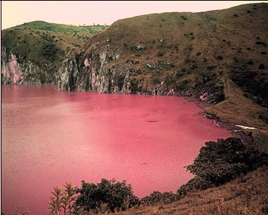
IMPACT OF NATURAL DISASTERS
Asia ranks first among all regions in all the categories of disaster occurrence, the number of killed and affected people and economic damage, accounting for 44.6 percent, 84.6 percent 87.1 percent and 49.0 percent respectively.
While Africa ranks the second in the number of killed and affected, its share in economic damages accounts for 0.2 percent, the lowest share.
Manjunathgouda M Patil, Asst.Prof. GIT Belgaum

Slide 15
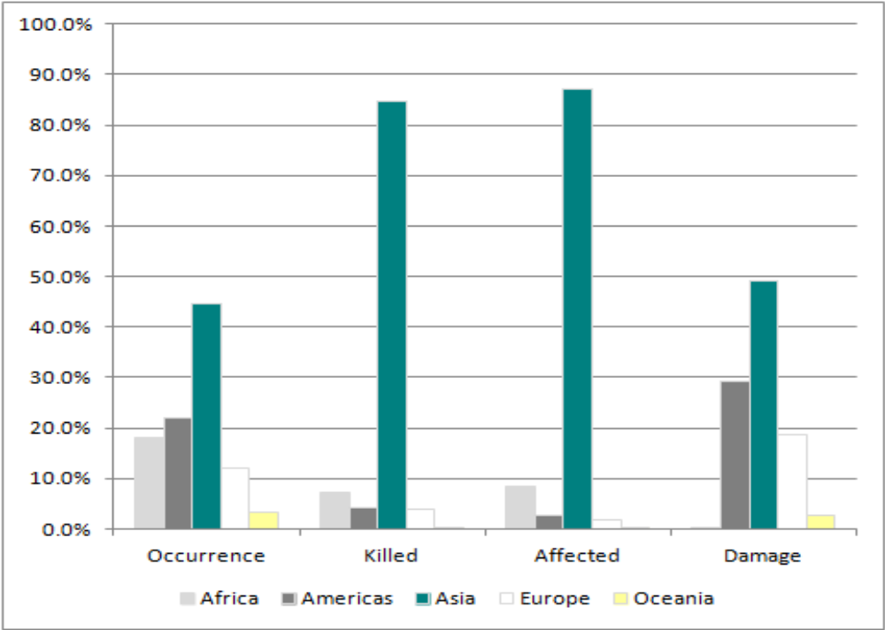
IMPACT OF NATURAL DISASTERS
Impacts of Natural Disasters by Region, 2013
Manjunathgouda M Patil, Asst.Prof. GIT Belgaum

Slide 16
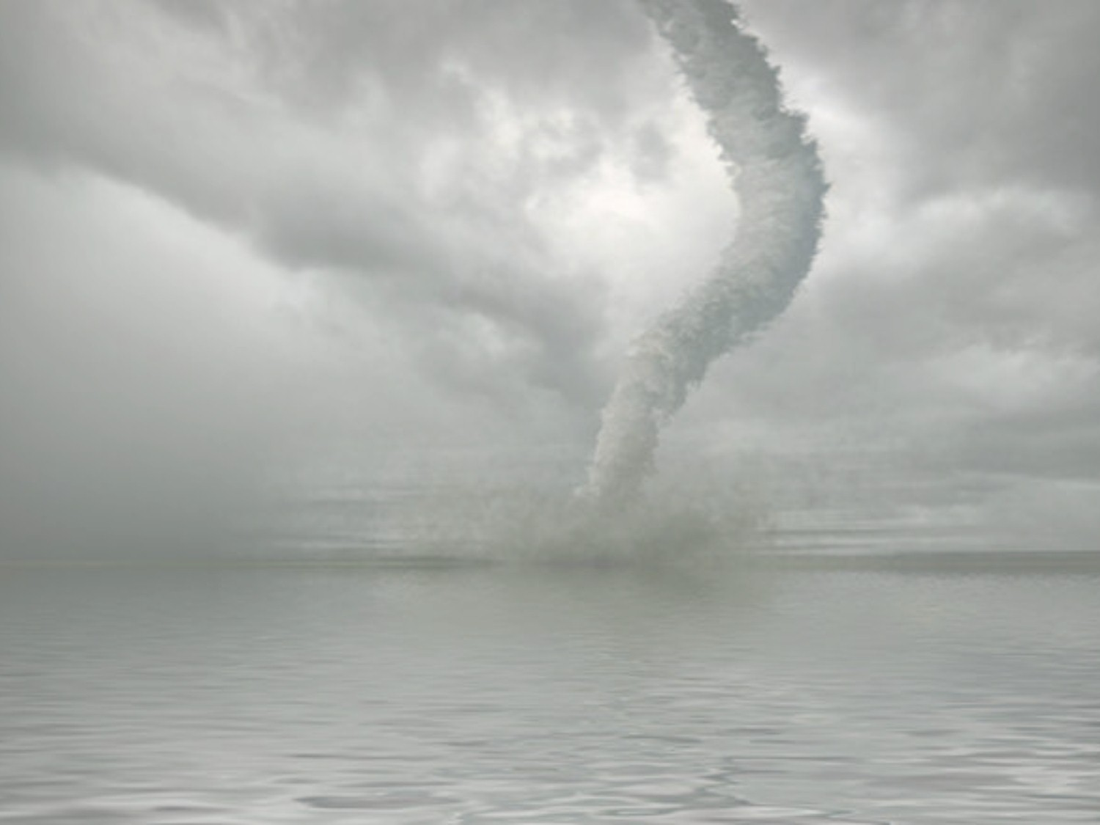
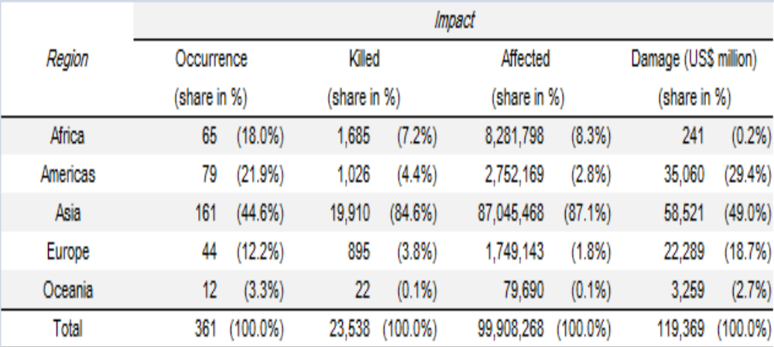
IMPACT OF NATURAL DISASTERS
Impacts of Natural Disasters by Region, 2013
Manjunathgouda M Patil, Asst.Prof. GIT Belgaum

Slide 17
IMPACT OF NATURAL DISASTERS
IMPACTS OF NATURAL DISASTERS BY DISASTER TYPE, 2013
This section provides the breakdown of impacts of disasters sorted by disaster type.
As Figure shows, two disasters, flood and storm, are dominant in all categories. While flood tops in occurrence, the number of people killed and damage, storm has highest the share of 49.2 percent in the number of people affected.
Manjunathgouda M Patil, Asst.Prof. GIT Belgaum

Slide 18
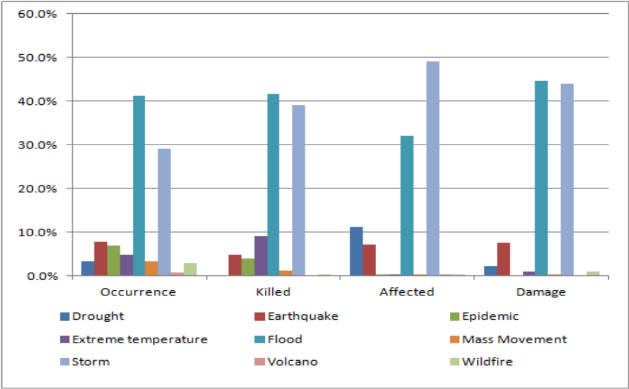
IMPACT OF NATURAL DISASTERS
Impacts of Natural Disasters by Disaster Type, 2013
Manjunathgouda M Patil, Asst.Prof. GIT Belgaum

Slide 19
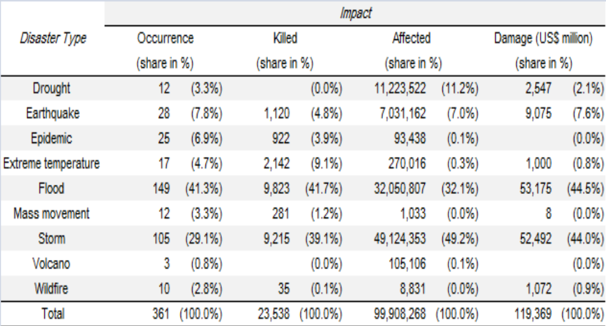
IMPACT OF NATURAL DISASTERS
Impacts of Natural Disasters by Disaster Type, 2013
Manjunathgouda M Patil, Asst.Prof. GIT Belgaum

Slide 20
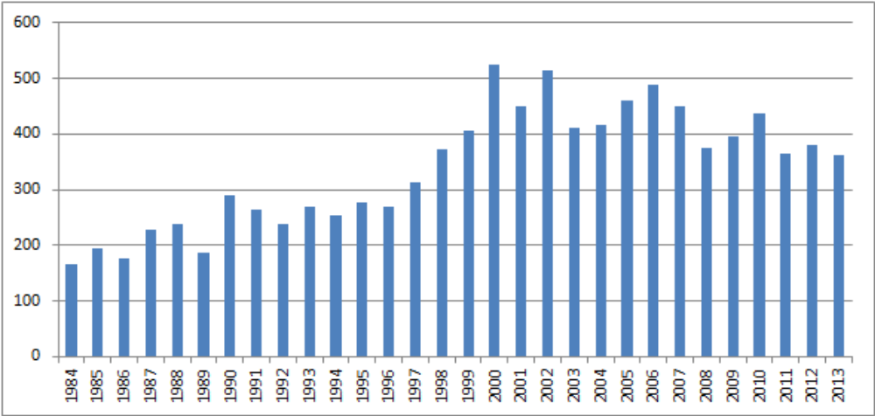
TRENDS OF WORLD NATURAL DISASTERS, 1984-2013
NUMBER OF DISASTERS IN THE WORLD (1984-2013)
In terms of number of disasters, the year 2013 sees slight decline from the previous year. In the long run, the upward shift of disaster occurrence’s trend continues from the early1980s through early 2000s.
Disaster Occurrence, 1984-2013
Manjunathgouda M Patil, Asst.Prof. GIT Belgaum

Slide 21
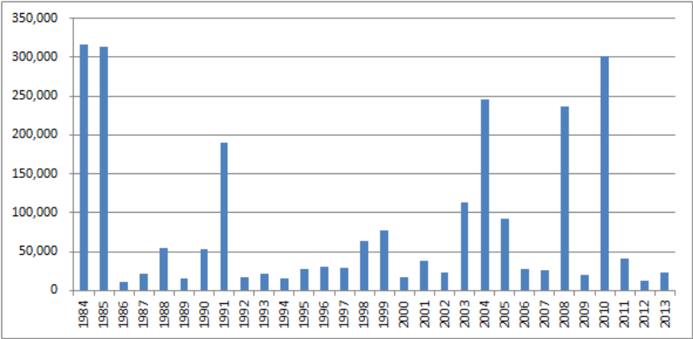
TRENDS OF WORLD NATURAL DISASTERS, 1984-2013
NUMBER OF PEOPLE KILLED IN THE WORLD (1984-2013)
The death toll in 2013, standing at 23,538 is doubled from the figure of previous year’s 10,783.
Number of People Killed, 1984-2013
Manjunathgouda M Patil, Asst.Prof. GIT Belgaum

Slide 22
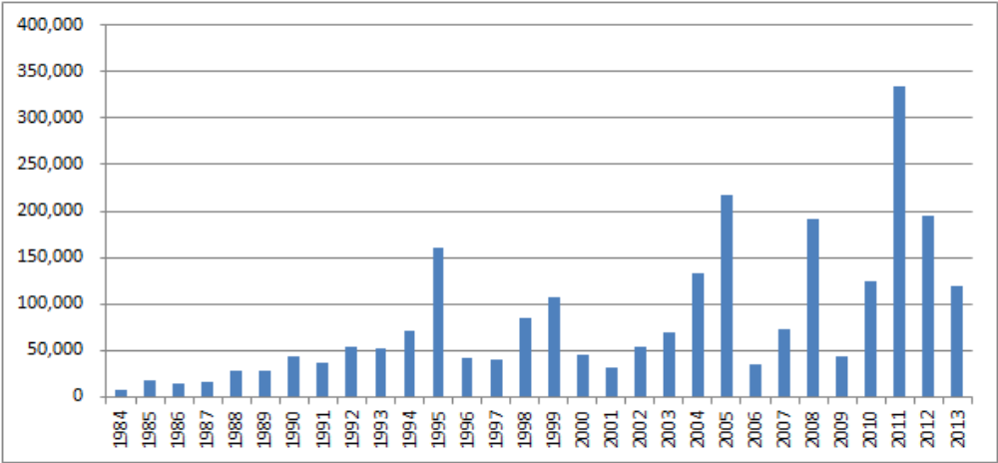
TRENDS OF WORLD NATURAL DISASTERS, 1984-2013
ECONOMIC DAMAGE IN THE WORLD (1984-2013)
Economic damage caused by natural disasters in 2013 (approximately US$119 billion) shows sharp decline from the previous year but it still ranks rather high in the period 1984-2013.
Amount of Damage, 1984-2013
Manjunathgouda M Patil, Asst.Prof. GIT Belgaum

Slide 23
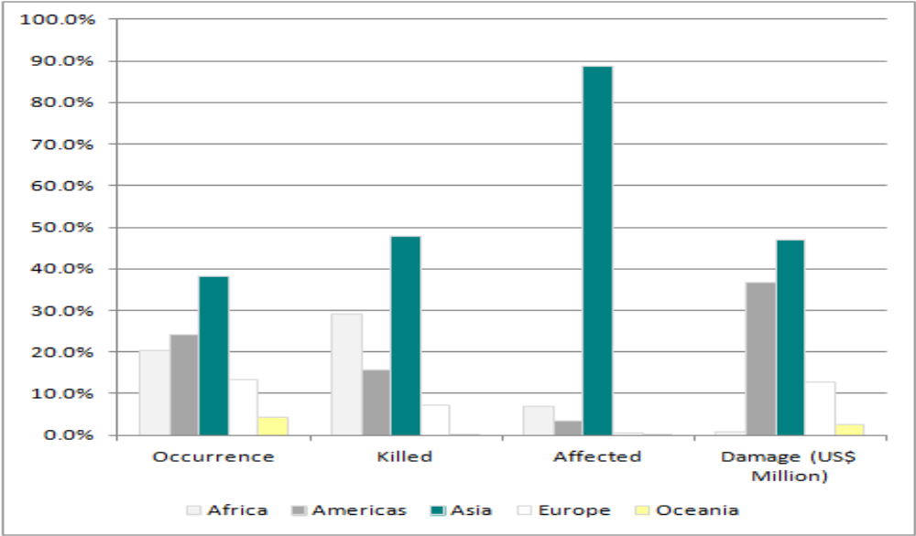
IMPACTS OF WORLD NATURAL DISASTERS BY REGION, 1984-2013
For the period 1984-2013, Asia dominates and ranks first in all natural disaster’s impact categories across regions of the world, especially in terms of the number of killed and affected.
Manjunathgouda M Patil, Asst.Prof. GIT Belgaum

Slide 24
Manjunathgouda M Patil, Asst.Prof. GIT Belgaum

